Slide 1
Kinematics Presentation Tom
3_27_25

Slide 2
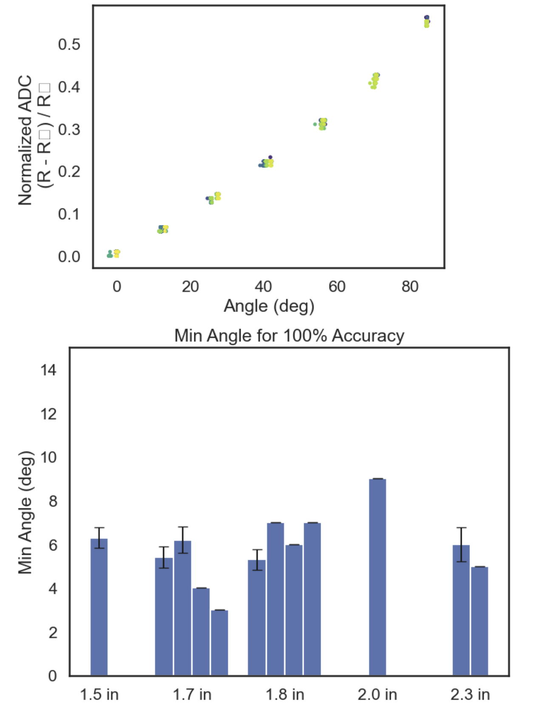
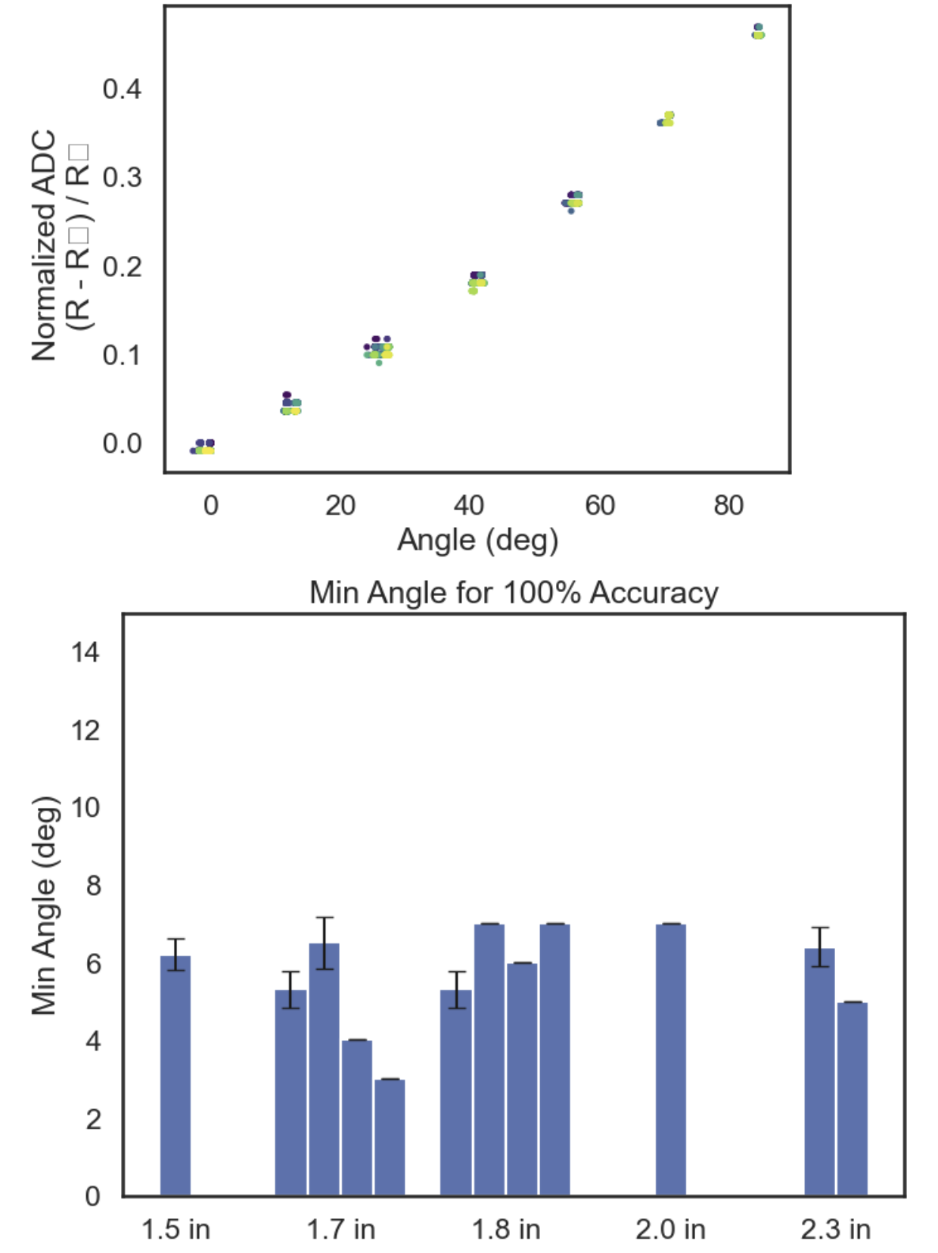
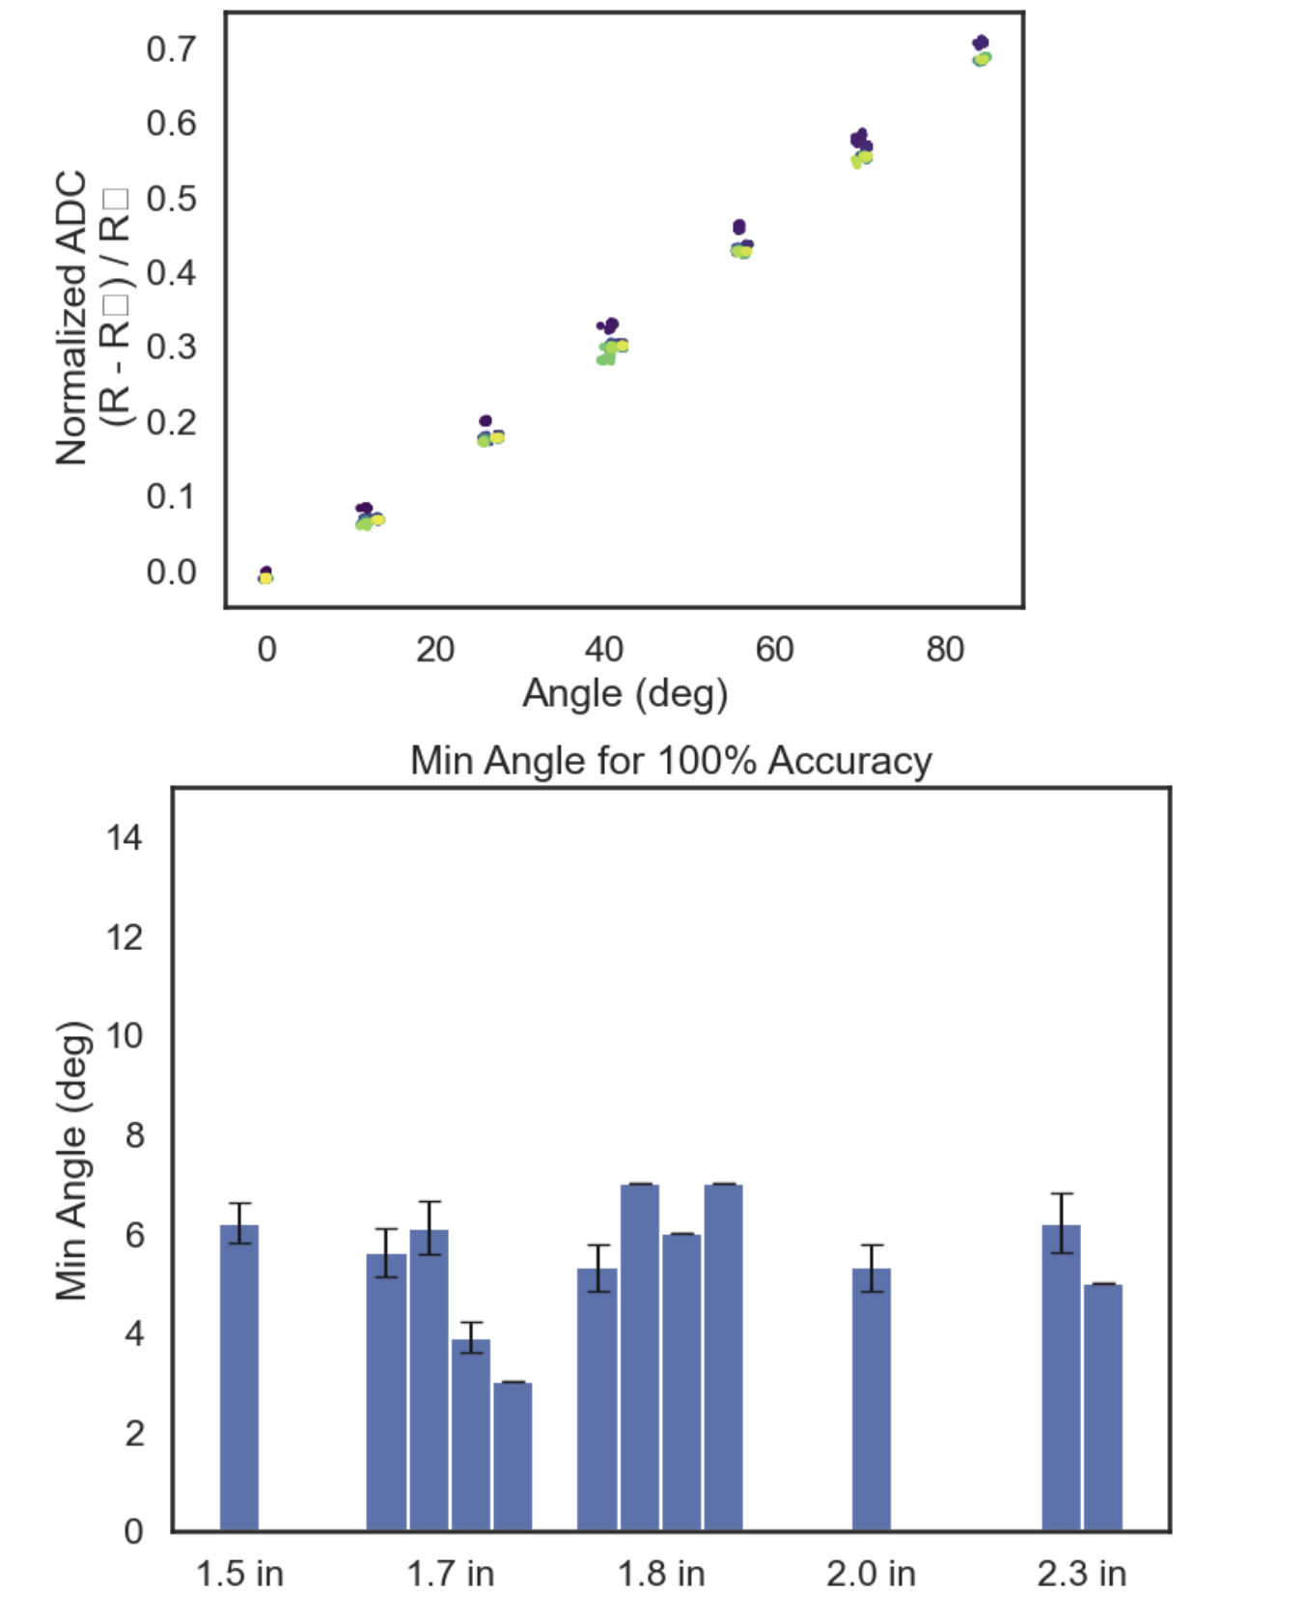
~0.67V source, 16 bit enc, 8x ADC gain, 100 ohm div
Just Re-testing previous
3.3V source, 16 bit enc, 8x ADC gain, 50 ohm div

Slide 3
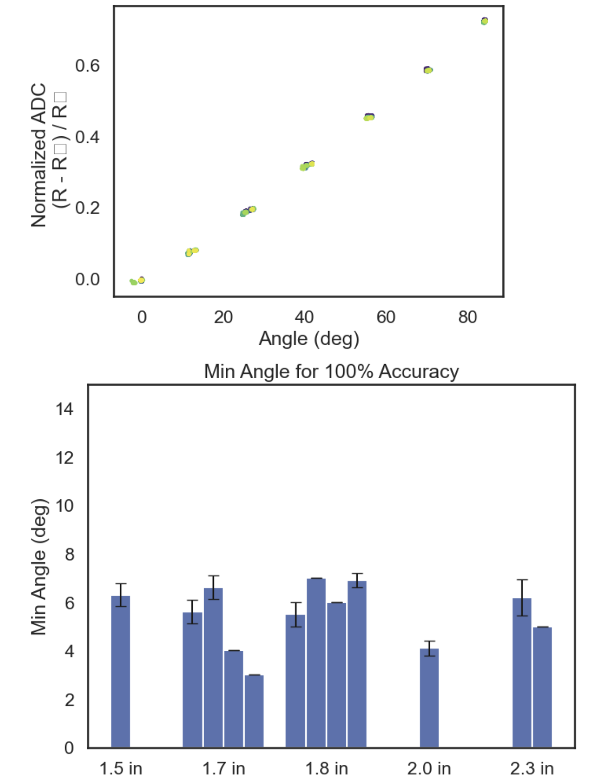
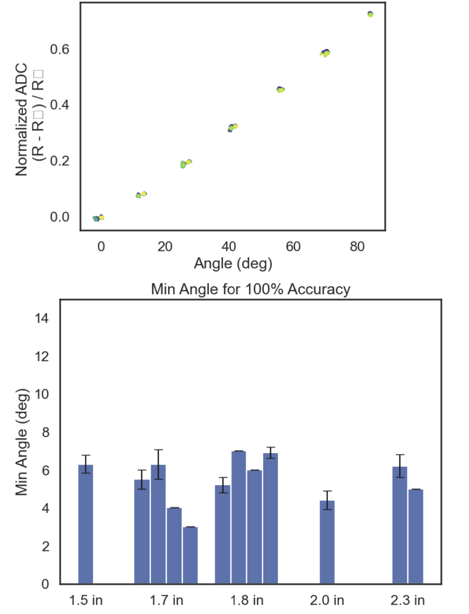
3.3V source from LVR and 2 x 10uF Caps, 16 bit enc, 8x ADC gain, 50 ohm div
3.3V source from LVR and 2 10uF Caps, 16 bit enc, 8x ADC gain, 40 ohm div (~15% of possible ADC range)
3.3V source, 16 bit enc, 8x ADC gain, 50 ohm div

